Slide 1







Decoupling Feature Extraction from Policy Learning: assessing benefits of state representation learning in goal based robotics
Natalia Díaz Rodríguez, PhD
www.robotsthatdream.eu
Antonin Raffin, Ashley Hill, René Traoré, Timothée Lesort, Natalia Díaz-Rodríguez, David Filliat
U2IS & INRIA FLOWERS Team, ENSTA ParisTech, Palaiseau, France
Notes:
Abstract:
One particularly rapidly evolving area within deep learning is the development of representation learning algorithms designed to learn abstract features that characterize data. State representation learning (SRL) focuses on a particular kind of representation learning where learned features are in low dimension, evolve through time, and are influenced by actions of an agent. In other words, SRL algorithms are built to capture factors of variation influenced by an agent in a given environment and project it into a disentangled and low dimensional space. As the representation learned captures the variation in the environment generated by agents, this kind of representation is particularly suitable for robotics and control scenarios. Moreover, the low dimension helps to overcome the curse of dimensionality and provides easier interpretation and utilization for both humans and other algorithms. Therefore, SRL can improve both human-machine interaction, performance and speed in policy learning algorithms such as reinforcement learning. I will present an overview covering the state-of-the-art on state representation learning in the most recent years considering methods that involve interaction with the environment and their applications in robotics control tasks. I will also present S-RL Toolbox (a toolbox for SRL for RL), an open source toolbox with data-generating environments, baselines and metric evaluation in reinforcement learning.
25min

Slide 2
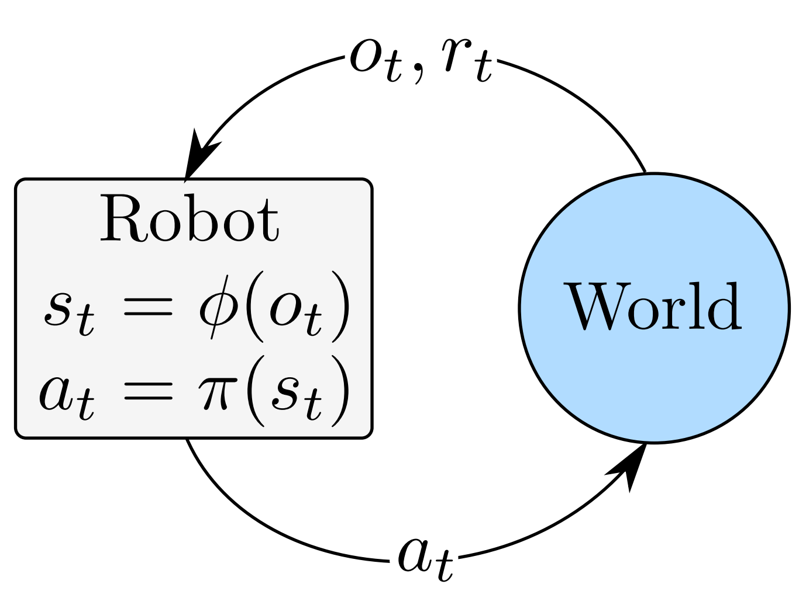
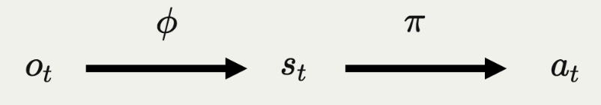
State Representation Learning (SRL) in RL context
SRL
[Lesort’18, State representation learning for control: An overview. Neural Networks]
Notes:
A robot will learn a state from an observation (such as an image) - learns a function \PHI that maps o->s
And will perform an action in that state according to a learned policy \PI s->a

Slide 3
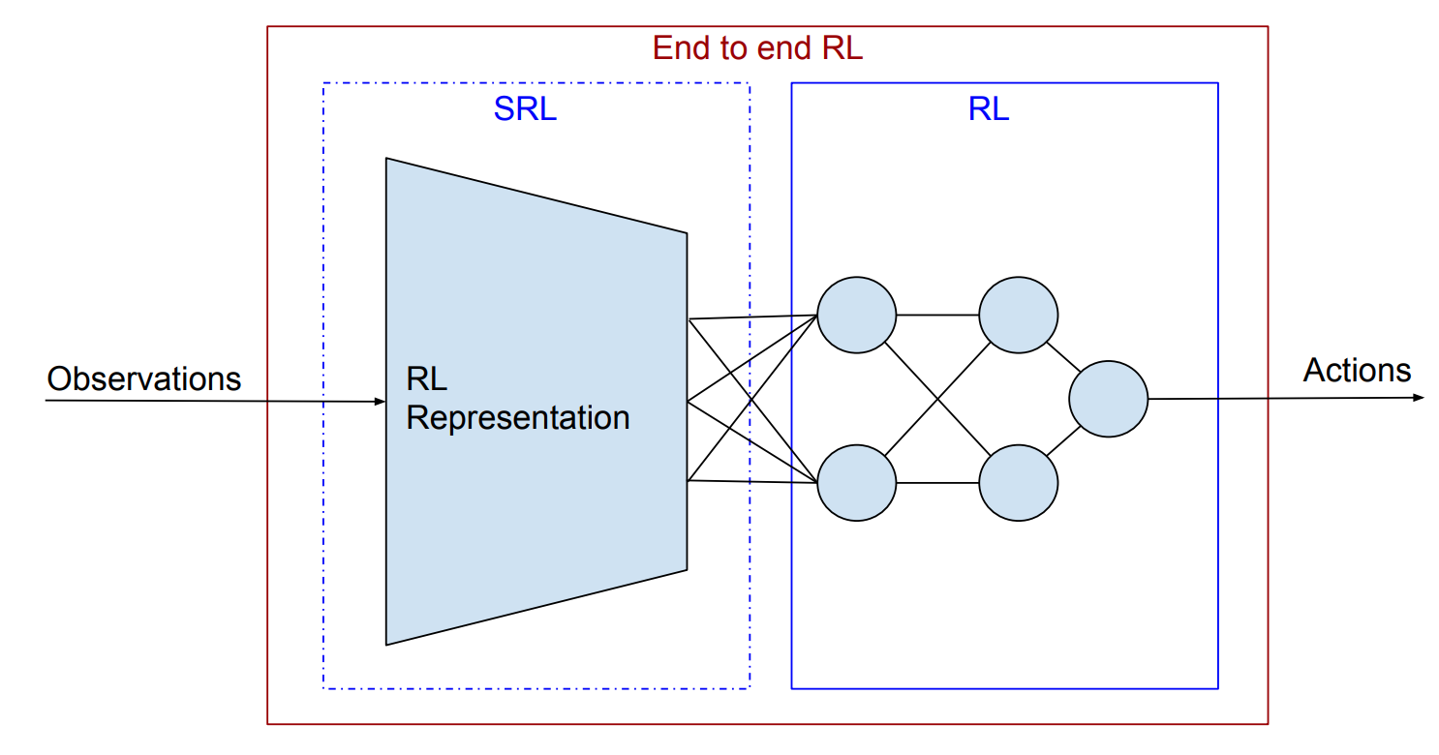
State Representation Learning (SRL) in RL context
[Lesort’18, State representation learning for control: An overview. Neural Networks]
Notes:
A robot will learn a state from an observation (such as an image) - learns a function \PHI that maps o->s
And will perform an action in that state according to a learned policy \PI s->a

Slide 4
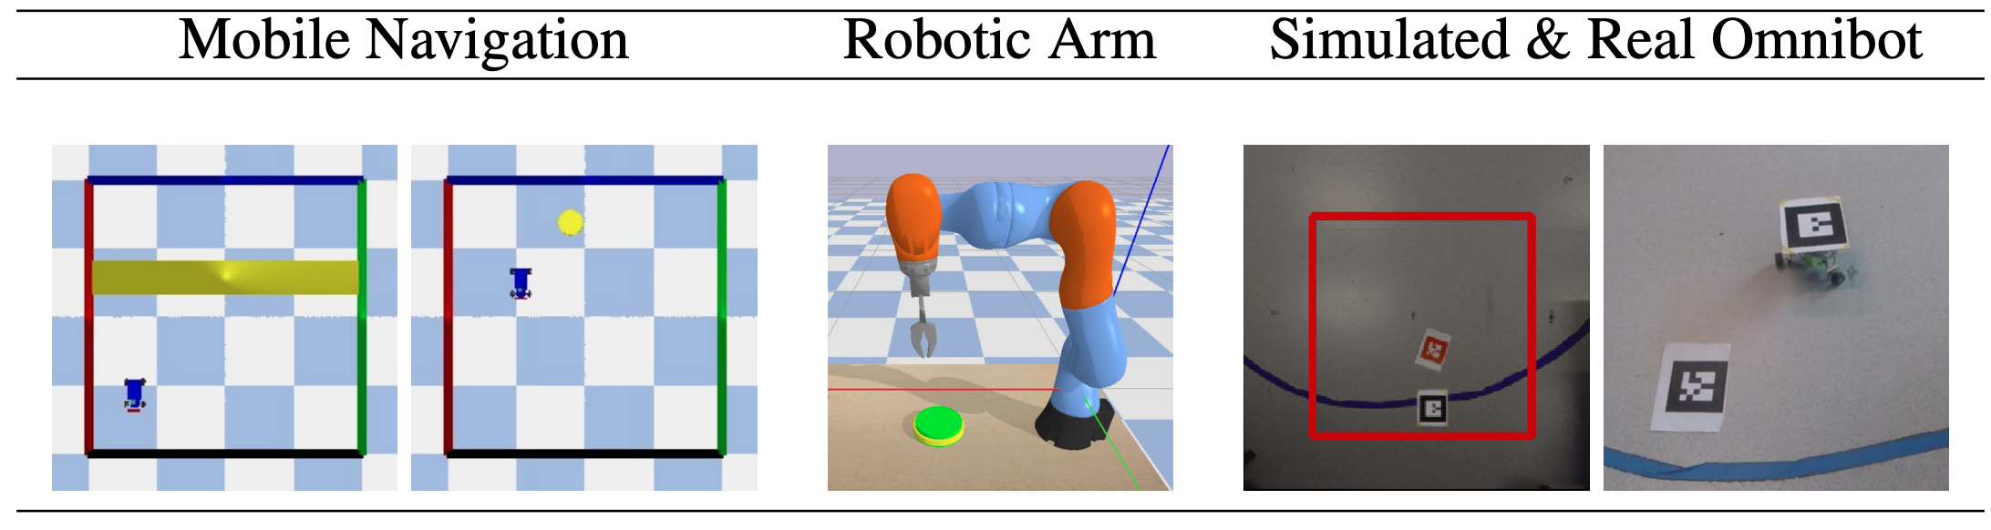
Goal based robotic tasks

Slide 5
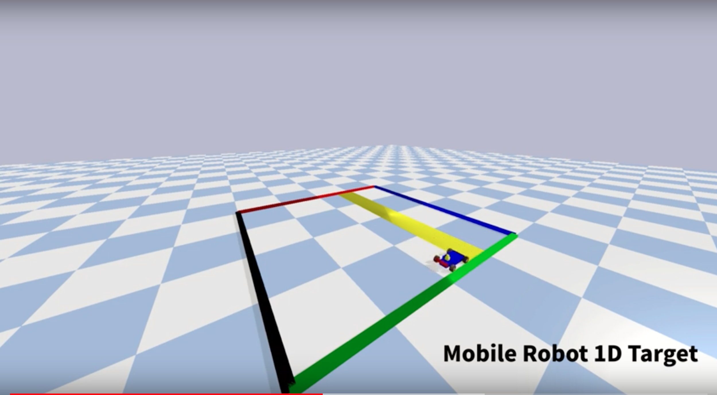
S-RL Toolbox

Slide 6
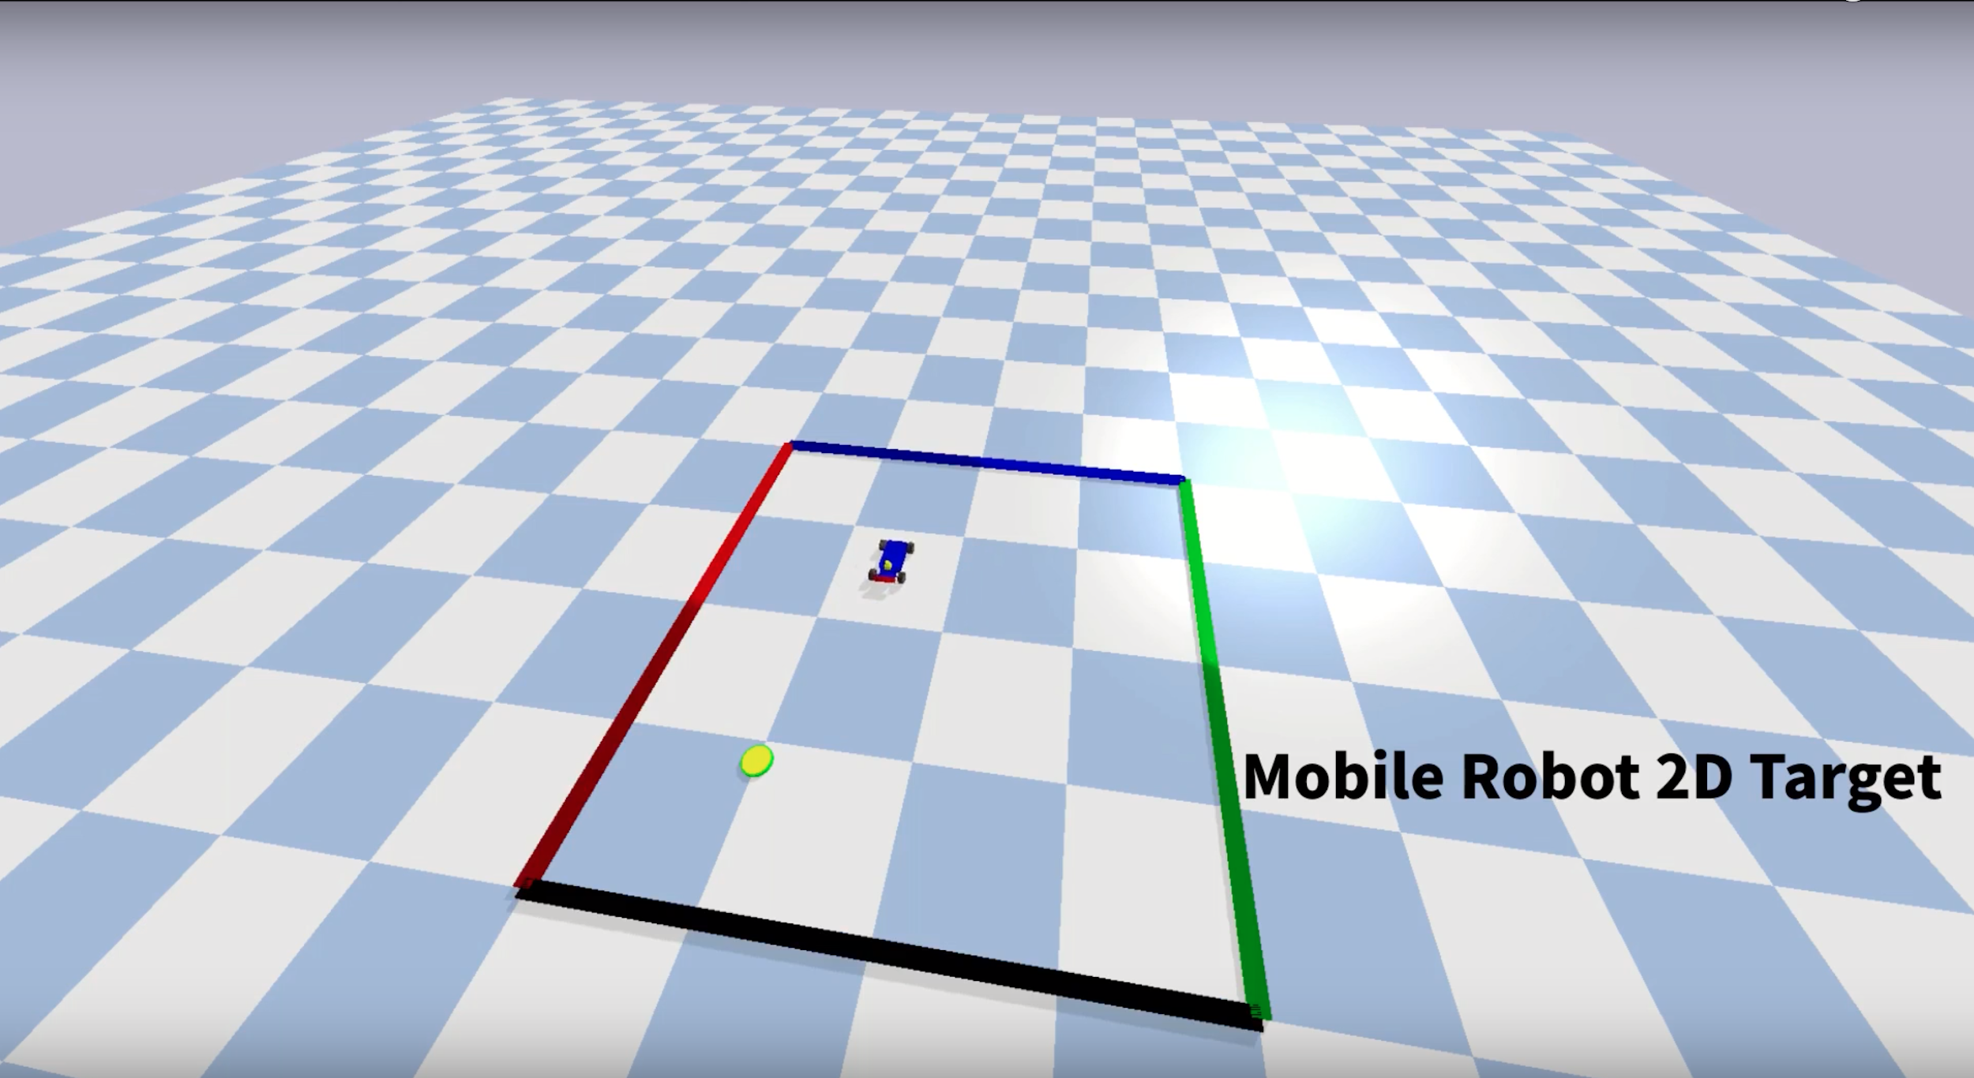
S-RL Toolbox

Slide 7
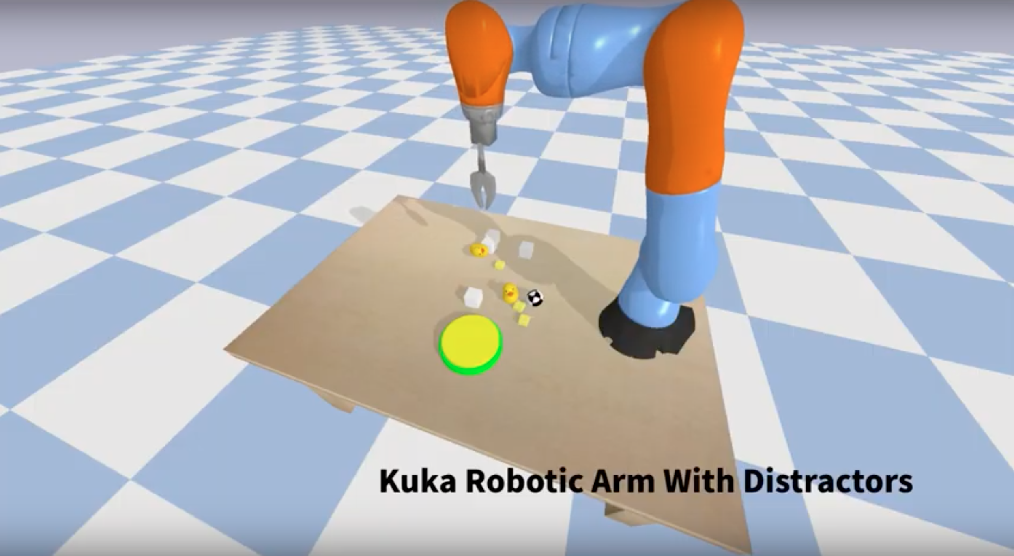
S-RL Toolbox

Slide 8
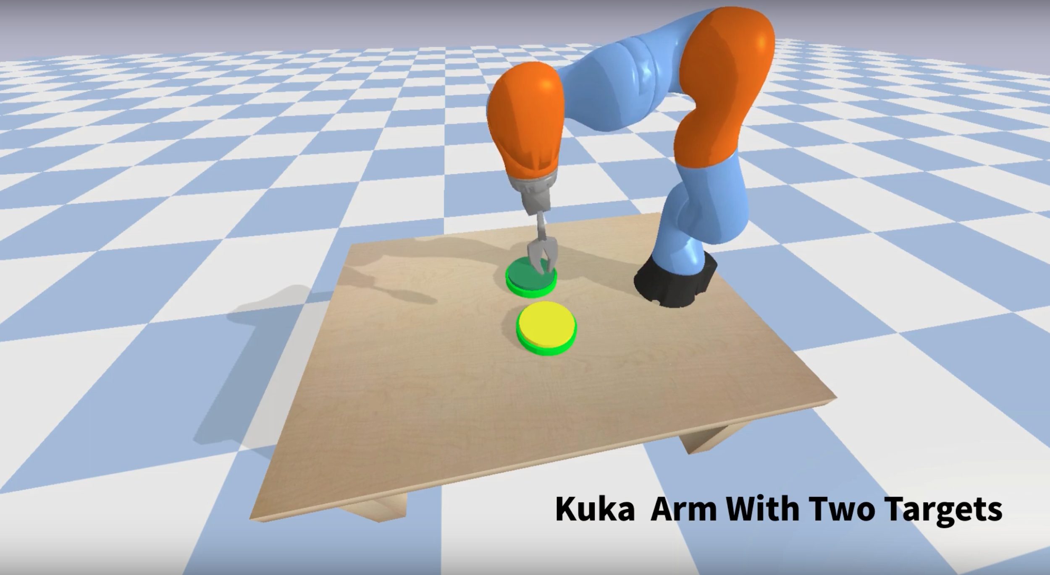
S-RL Toolbox
Notes:
Can he learn to figure out puzzles?

Slide 9
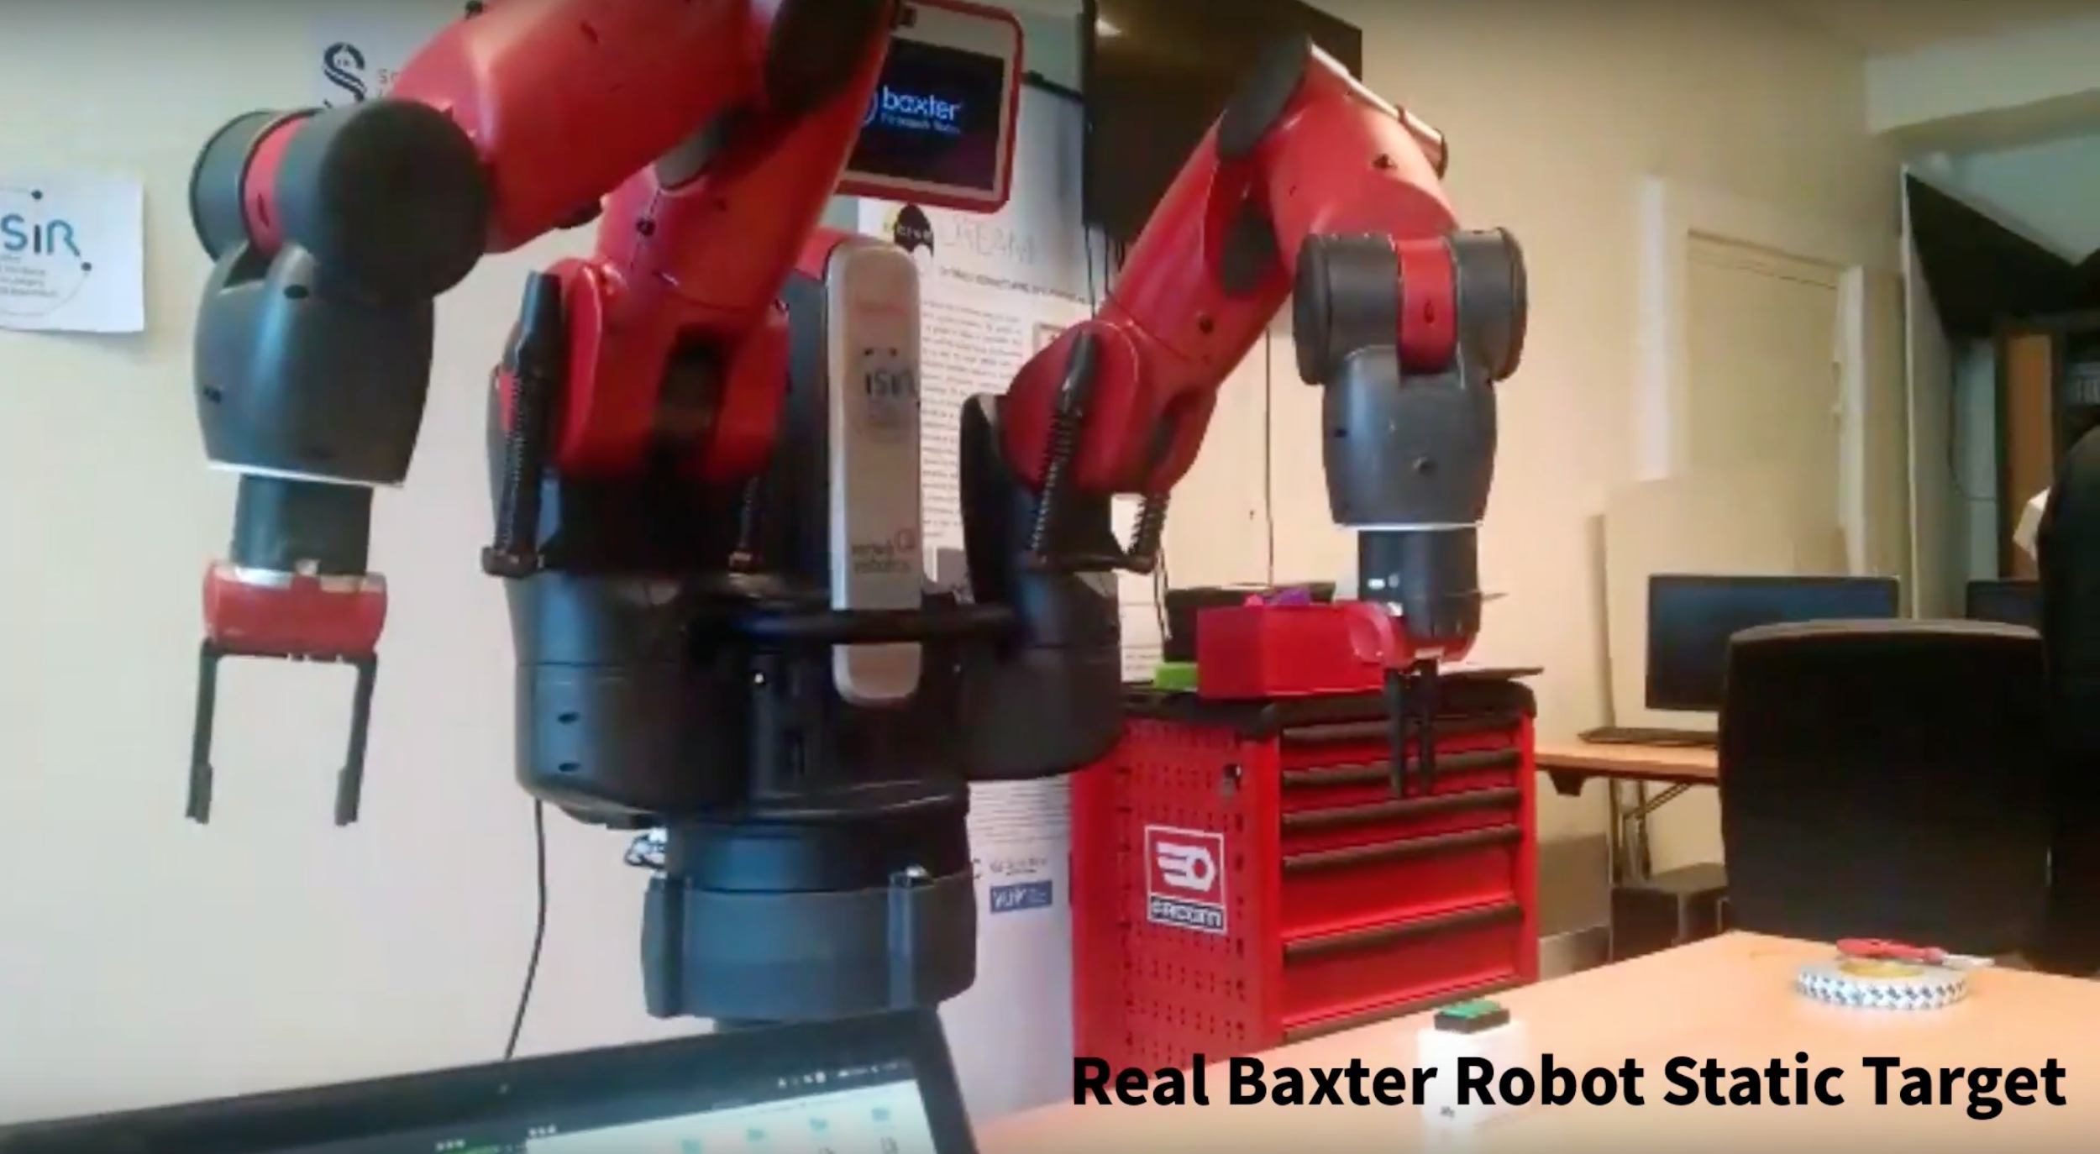
S-RL Toolbox

Slide 10
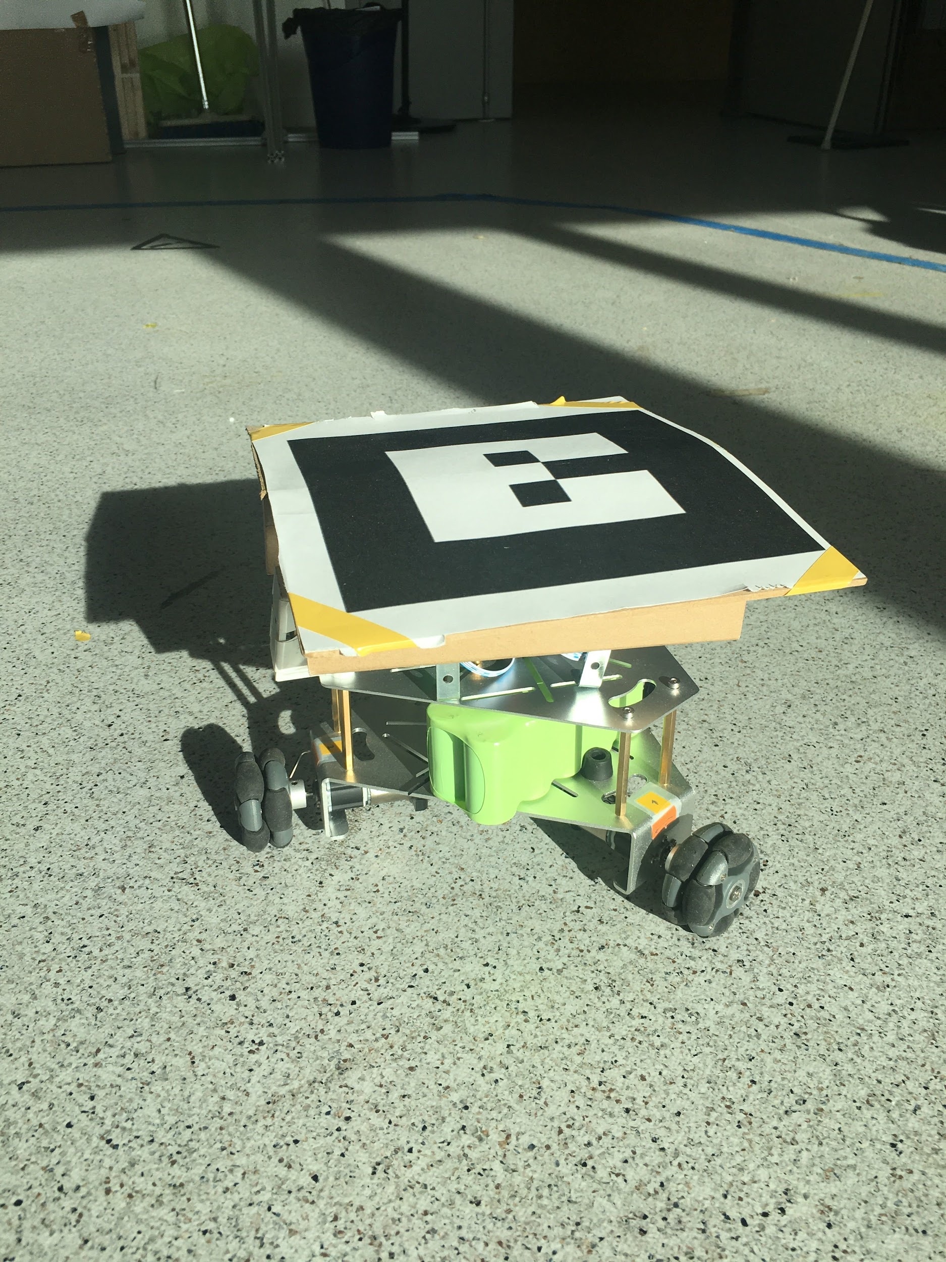
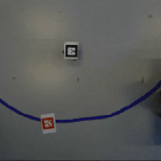
S-RL Toolbox

Slide 11
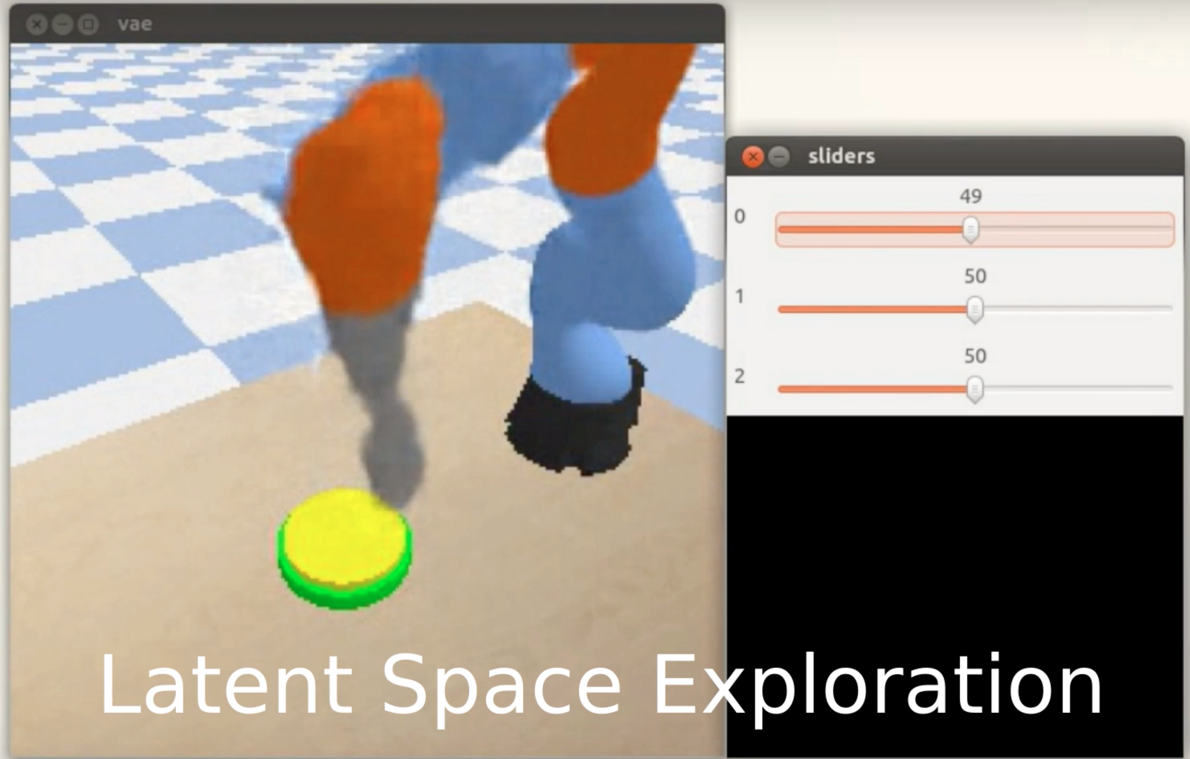
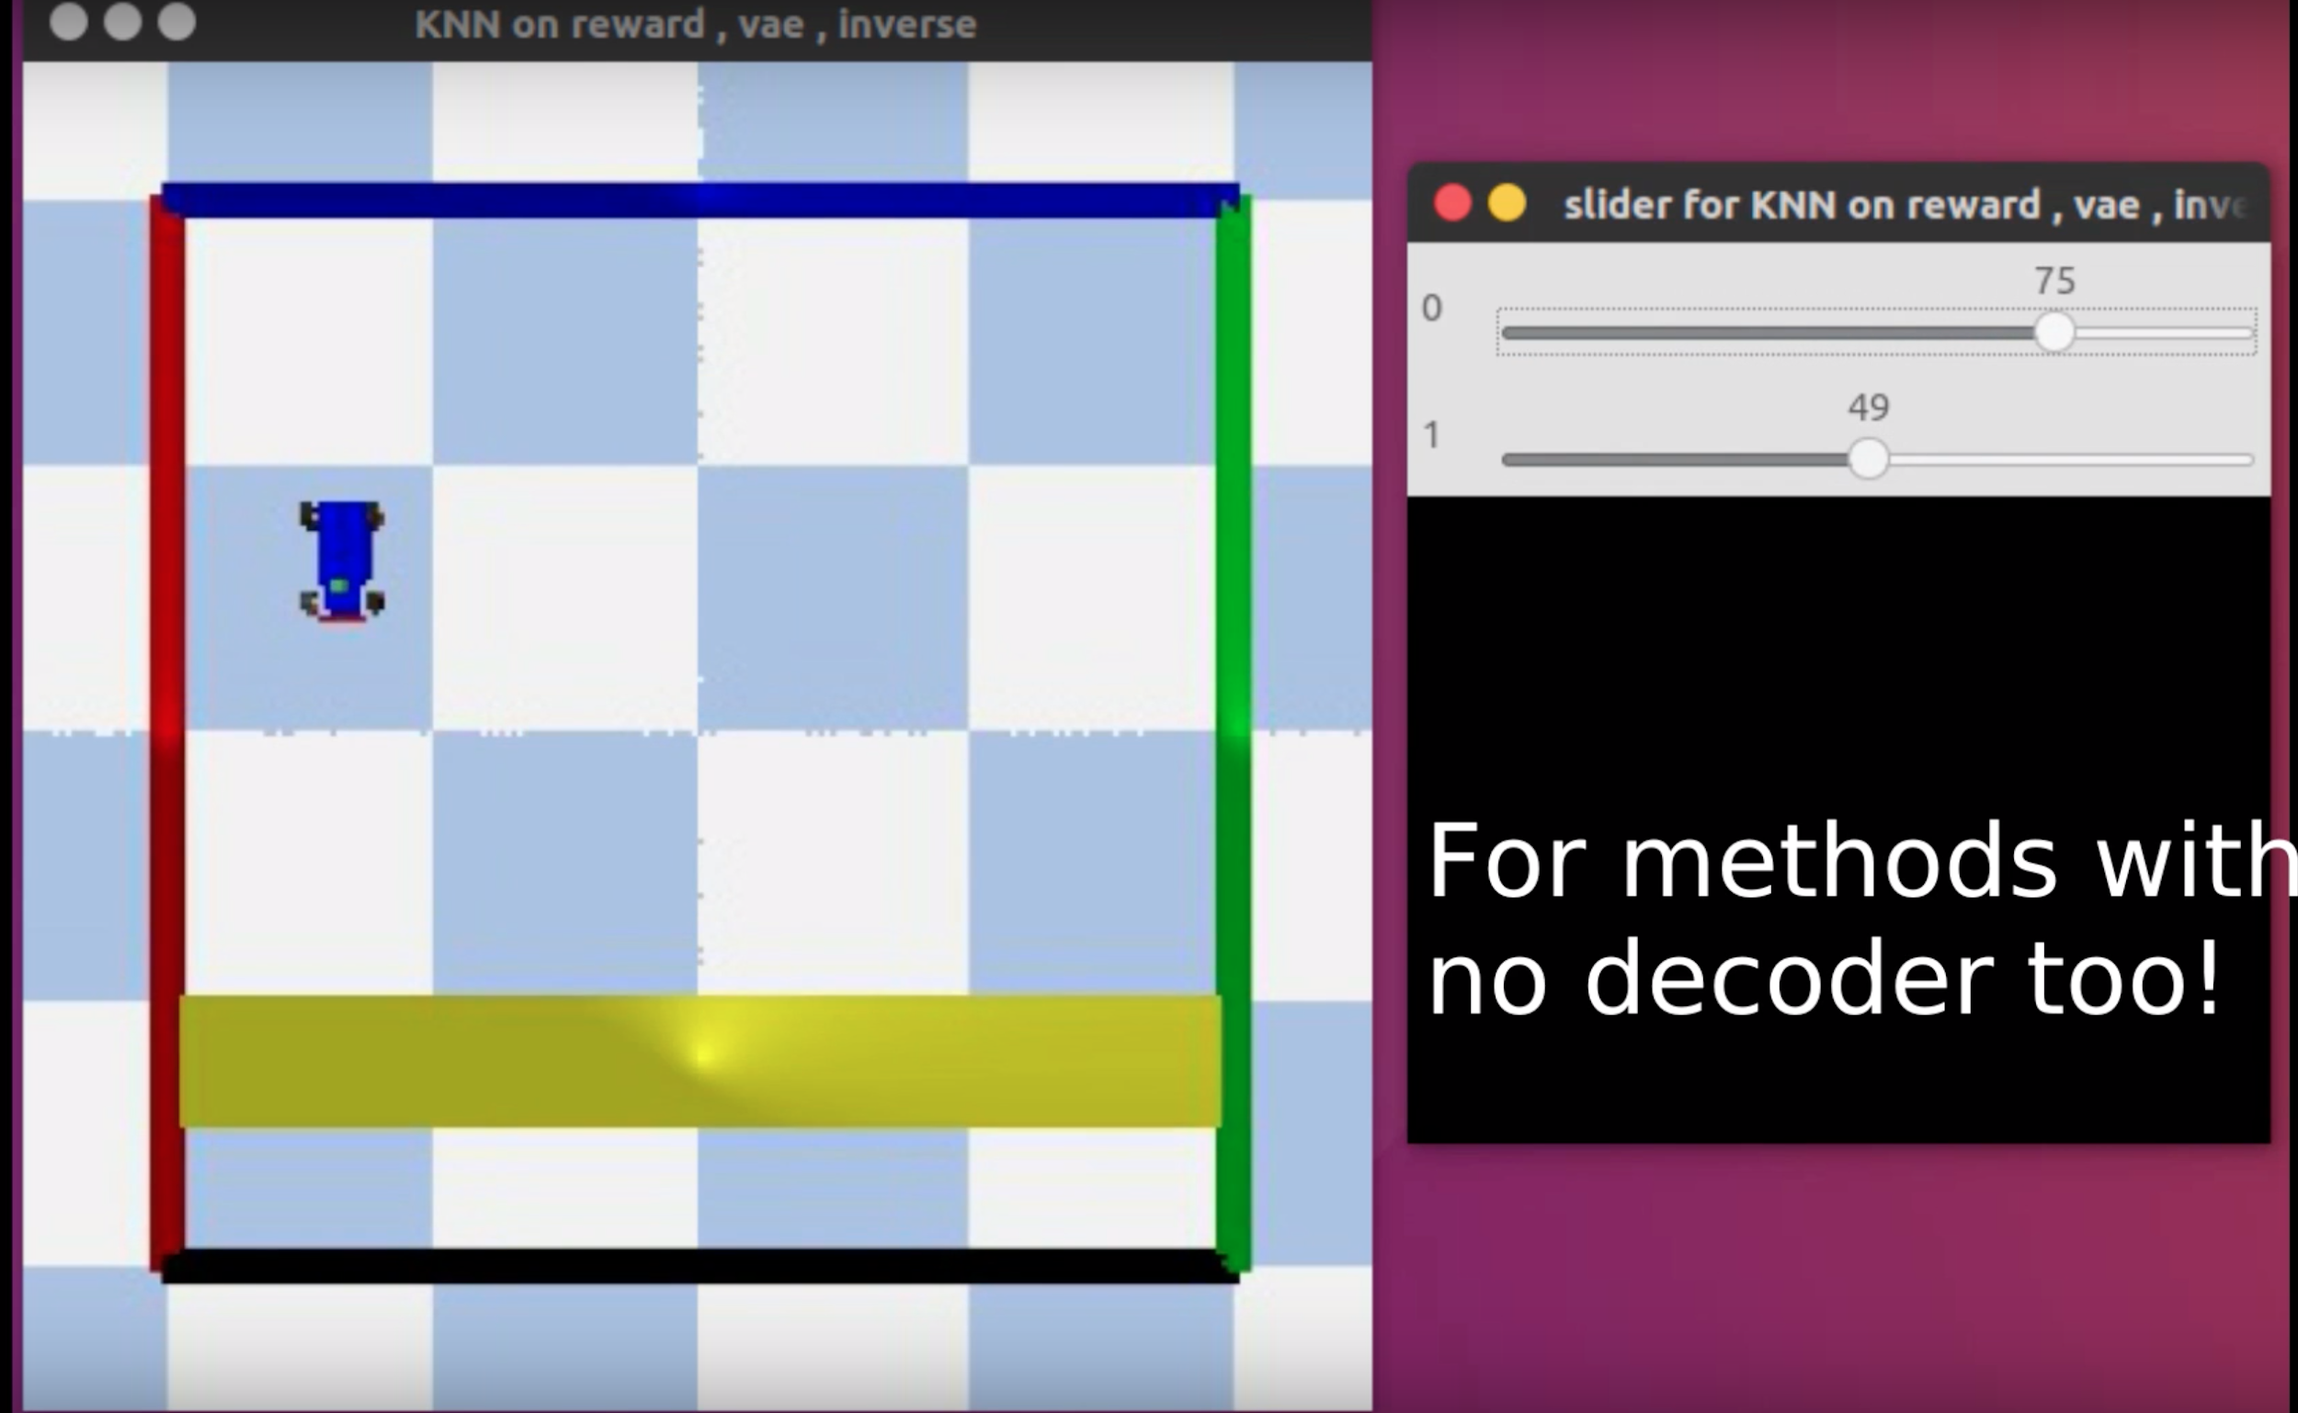
S-RL Toolbox

Slide 12
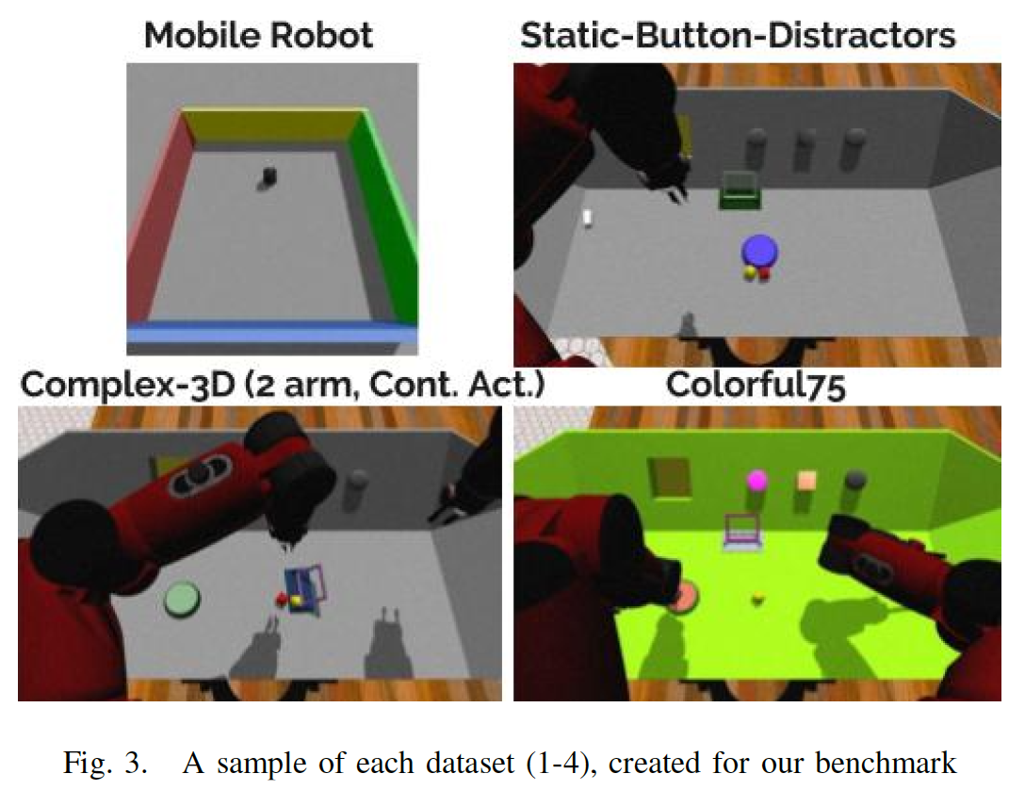
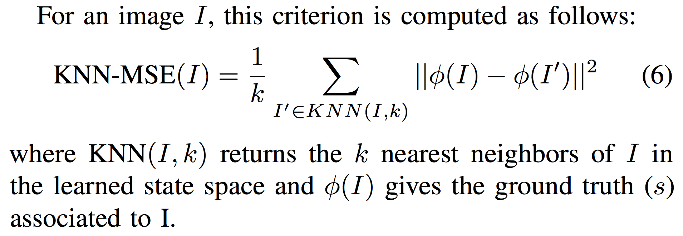
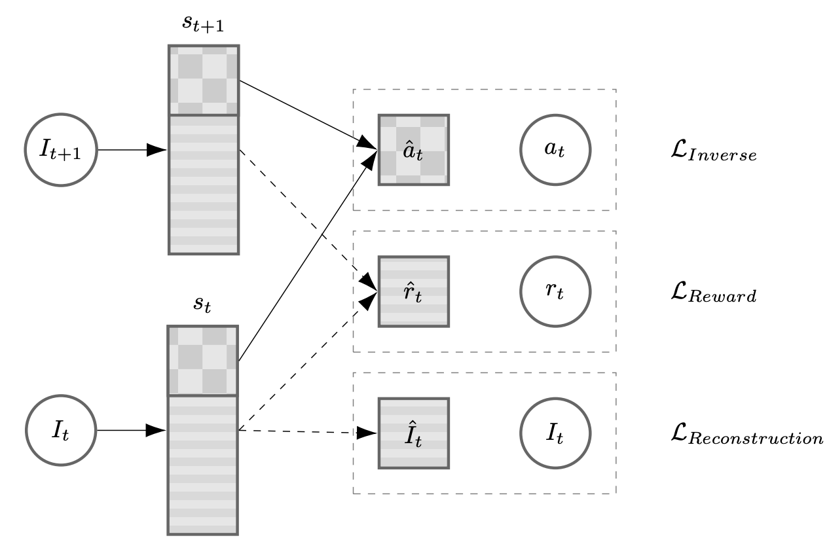
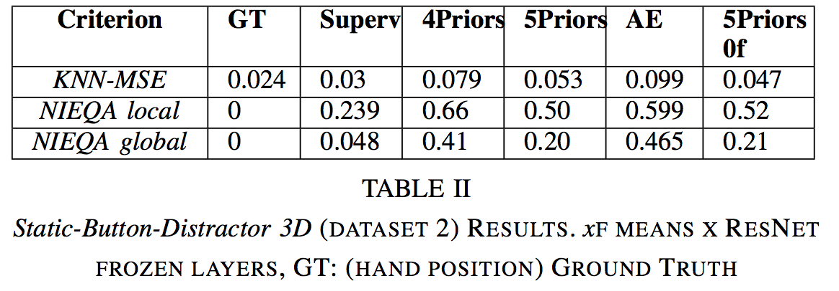
Decoupling feature extraction from policy learning
[Raffin et al.18]
Notes:
Splitting instead of combining state representations

Slide 13
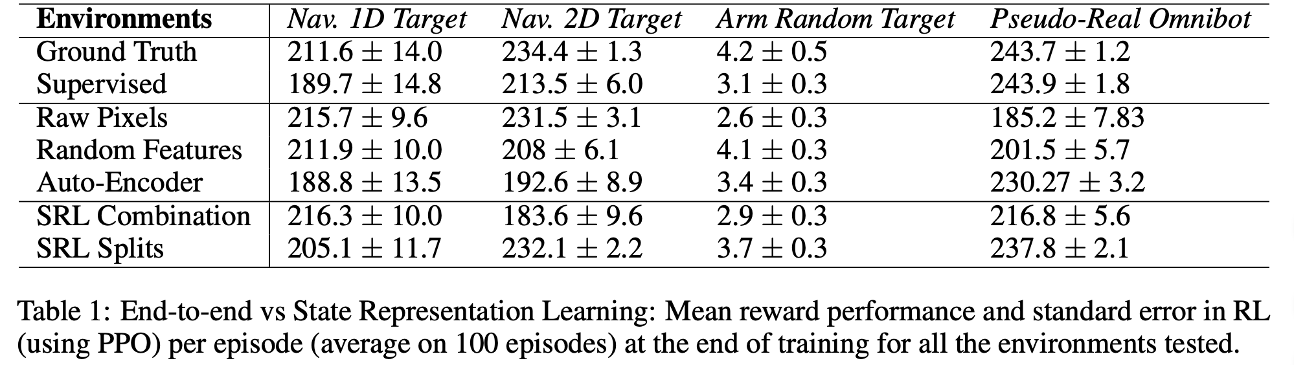
Baselines and Results

Slide 14
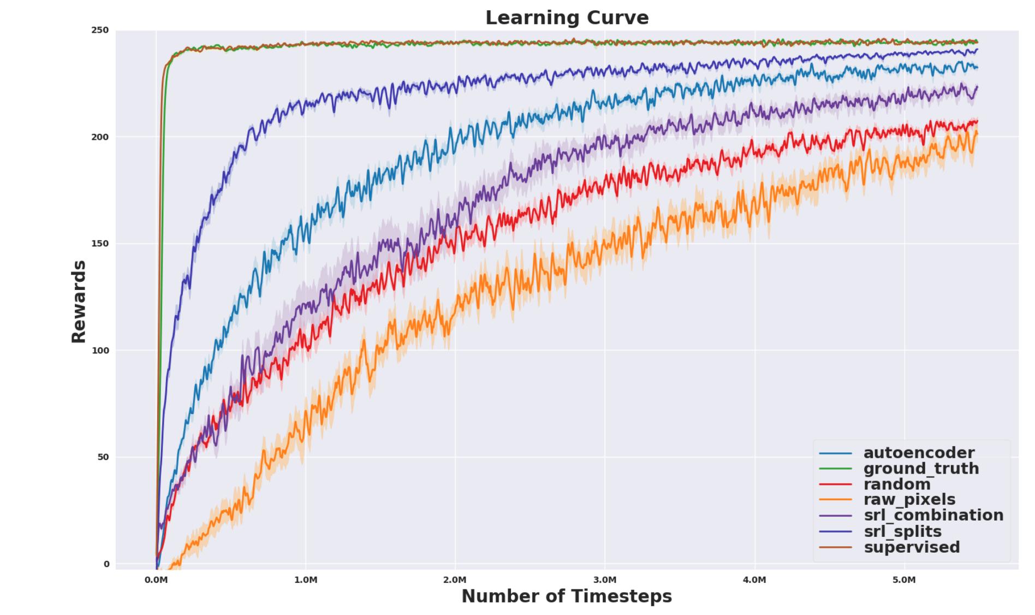

Slide 15
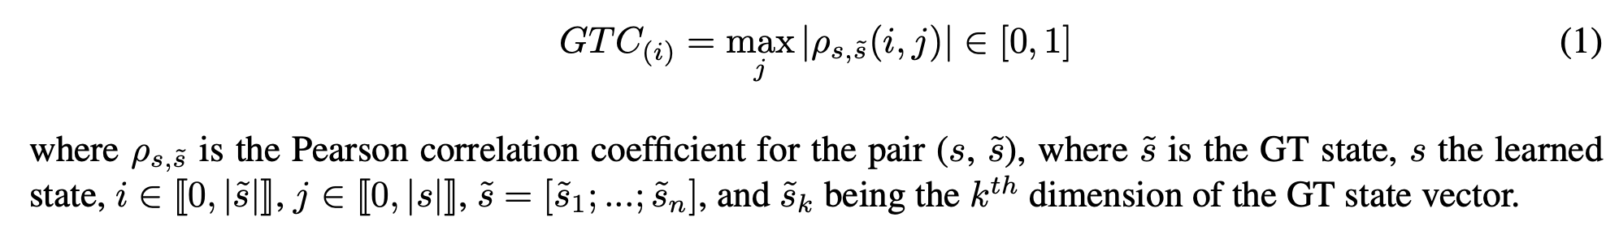

Slide 16
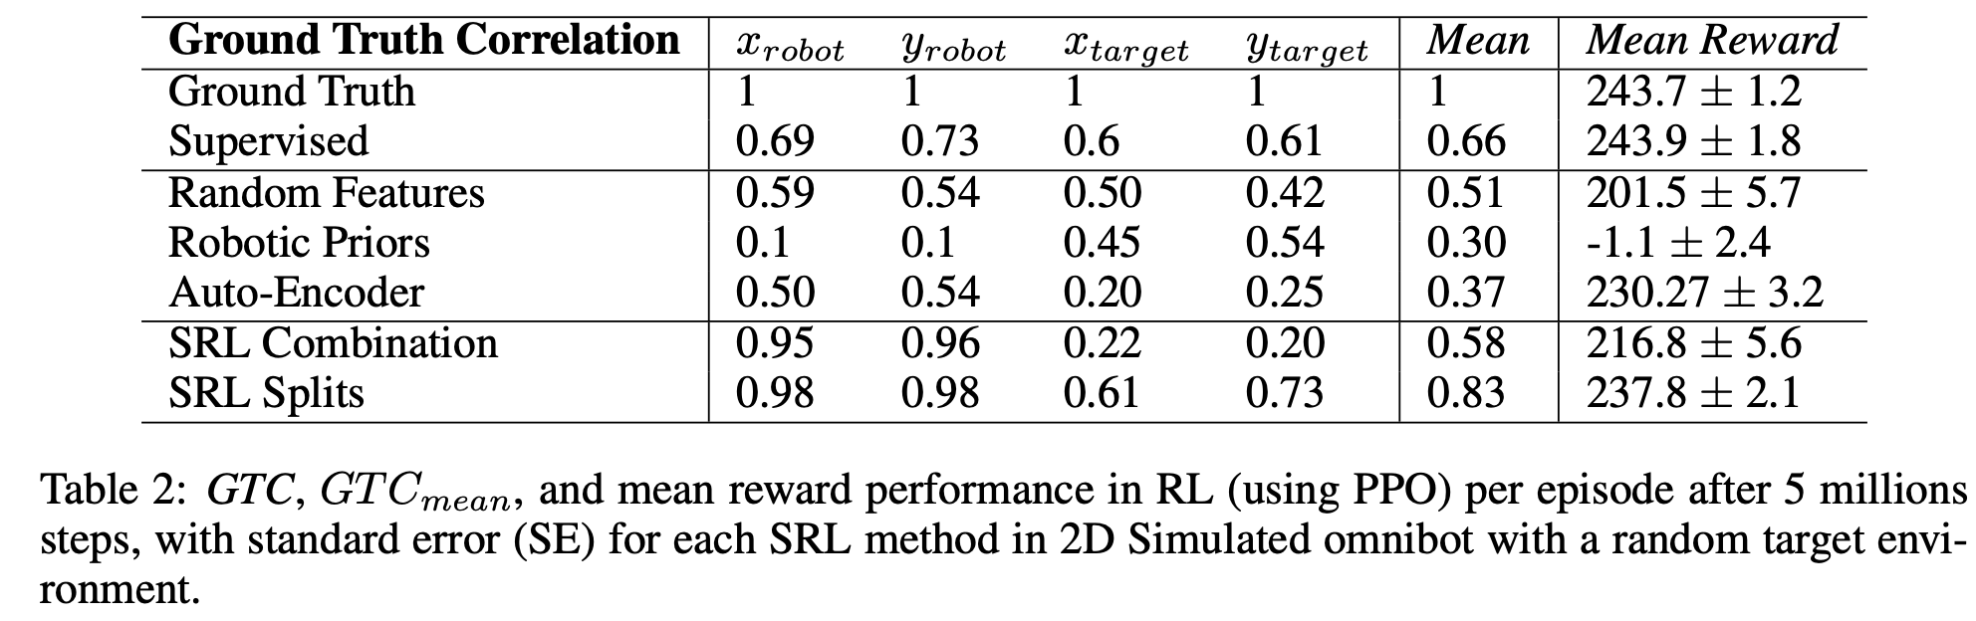

Slide 17
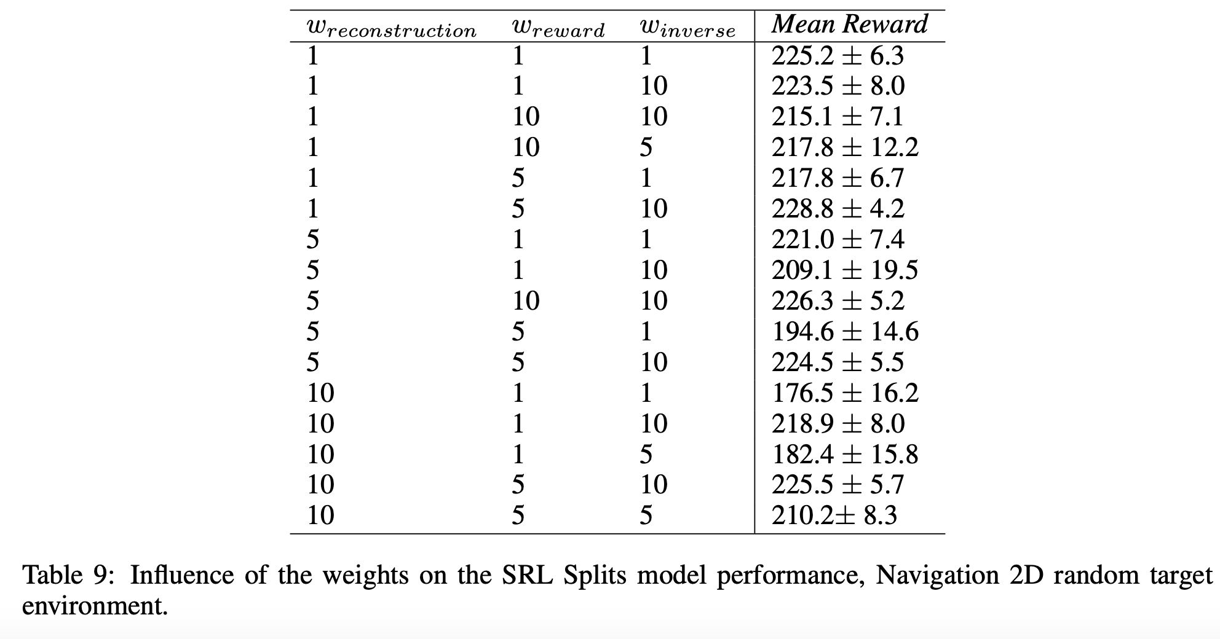

Slide 18
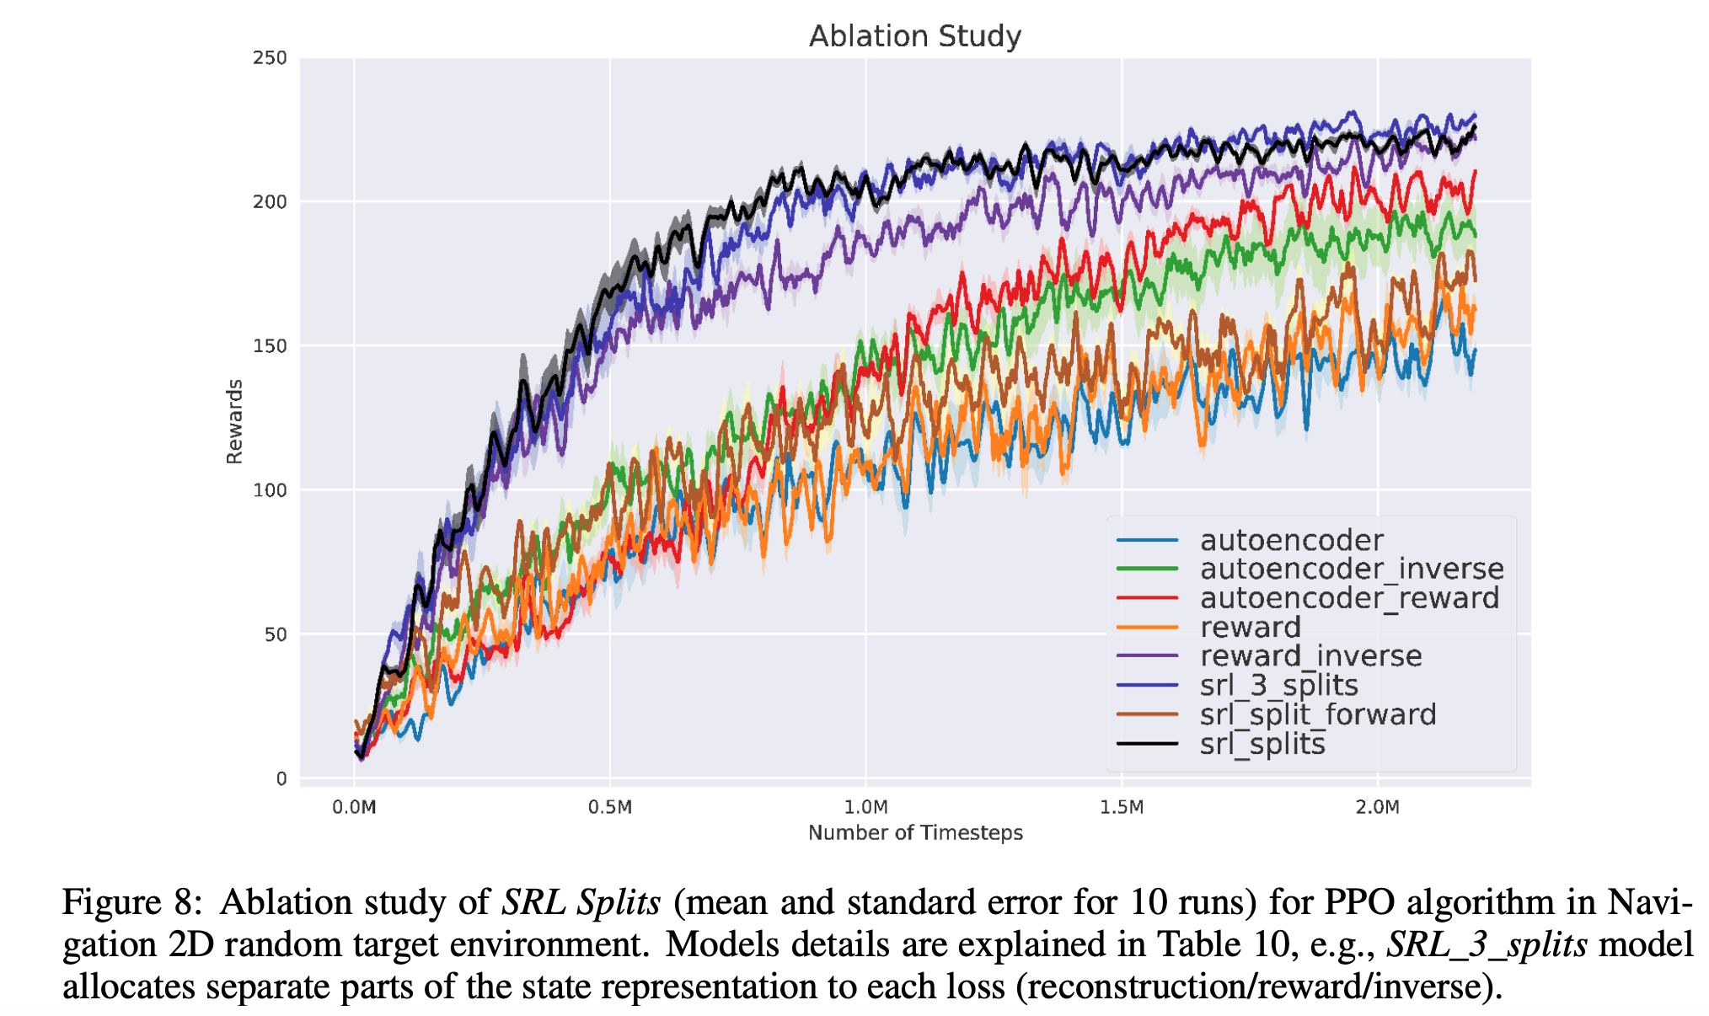

Slide 19
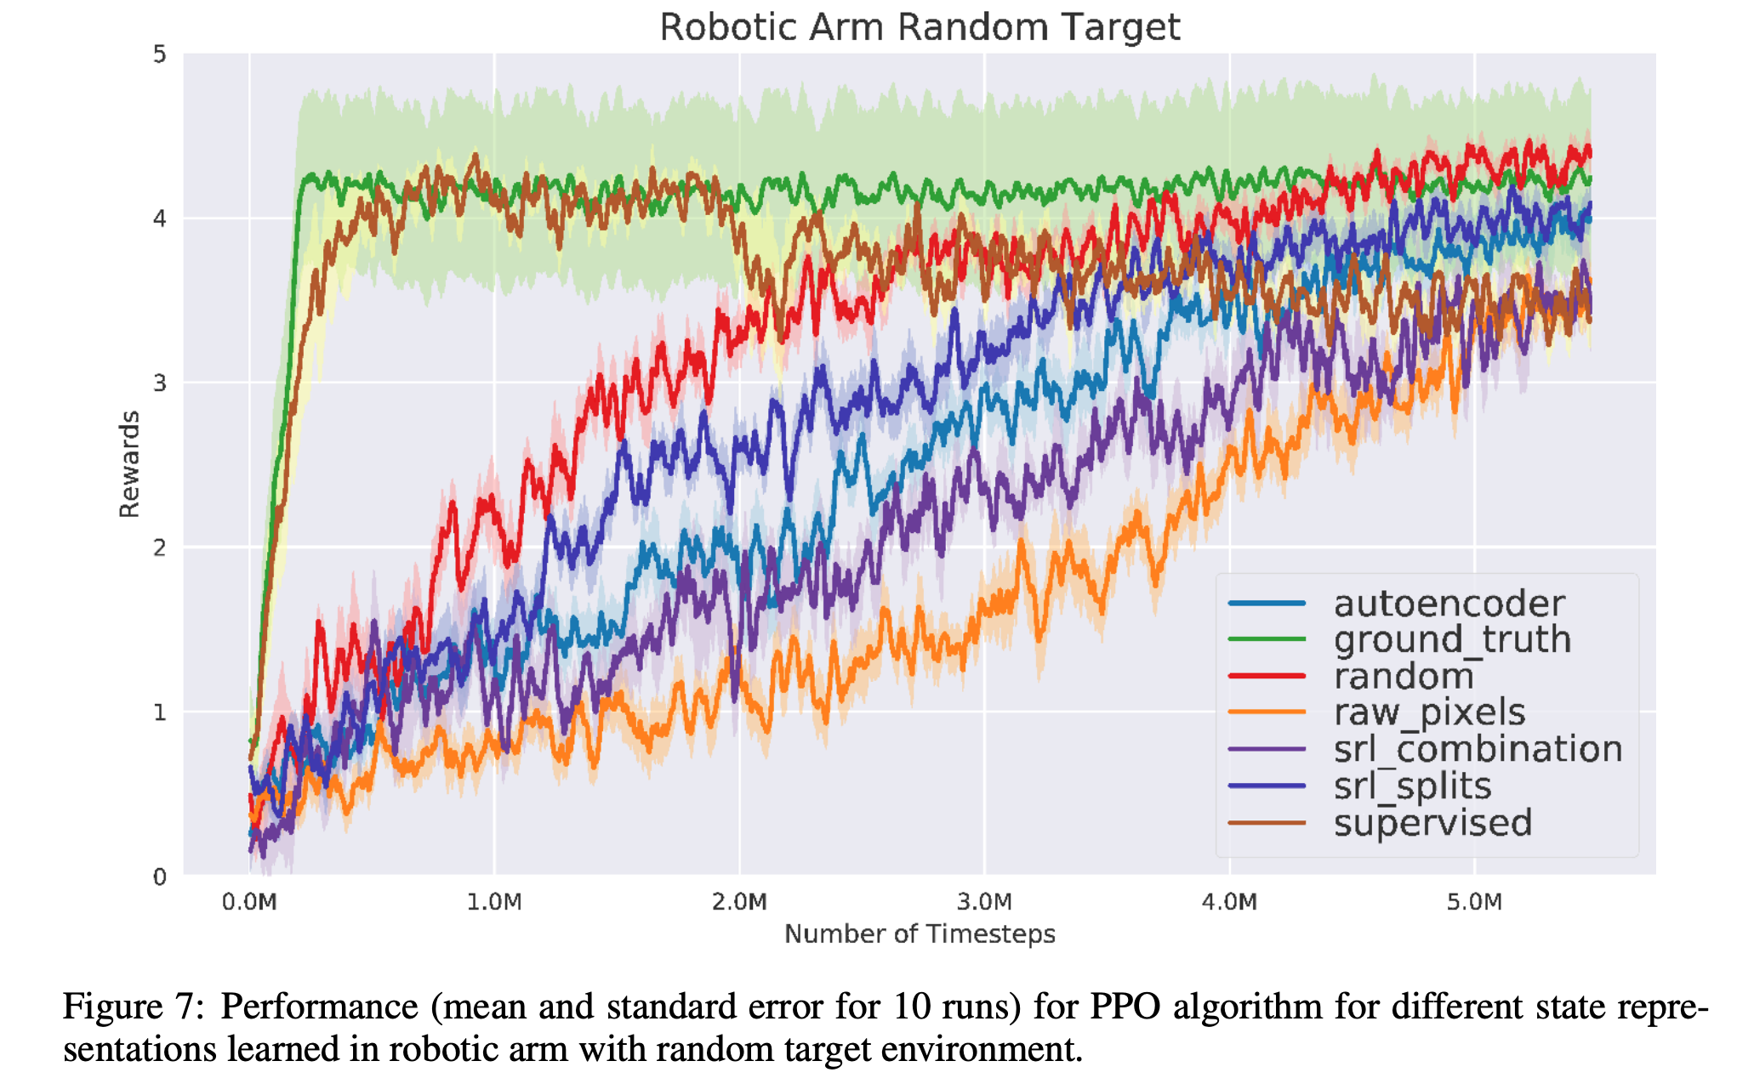
Random Features are a great baseline….

Slide 20
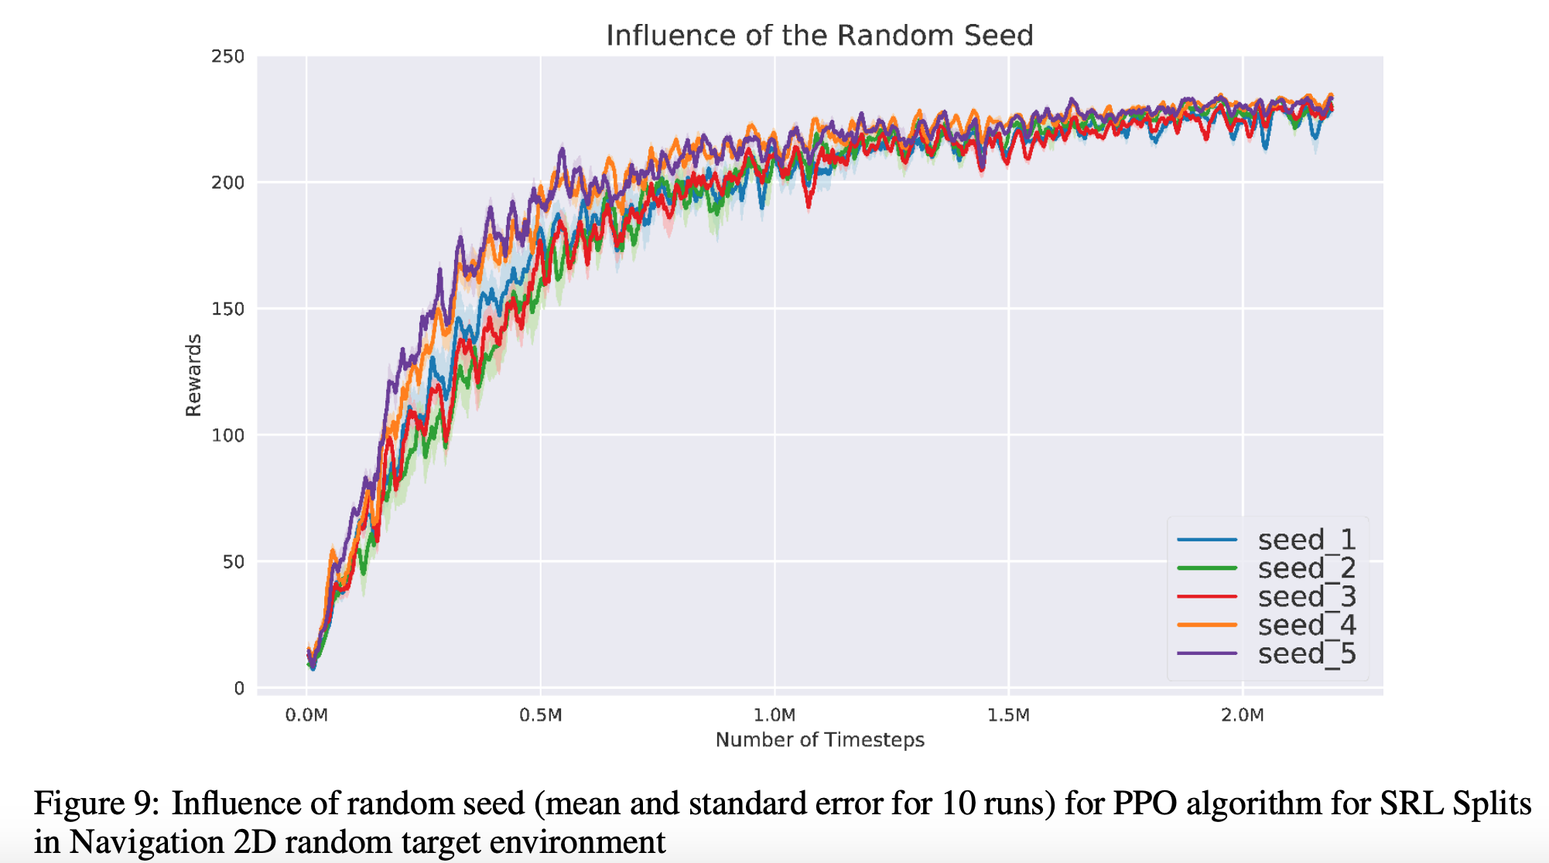

Slide 21
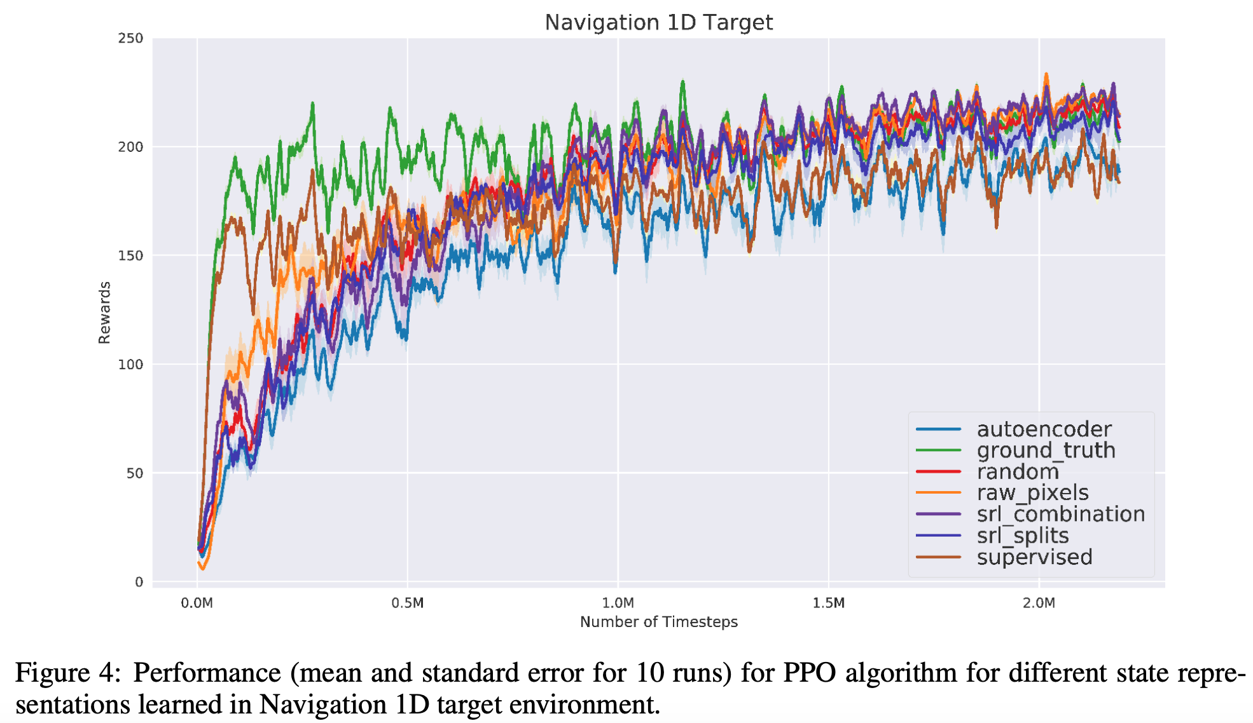

Slide 22
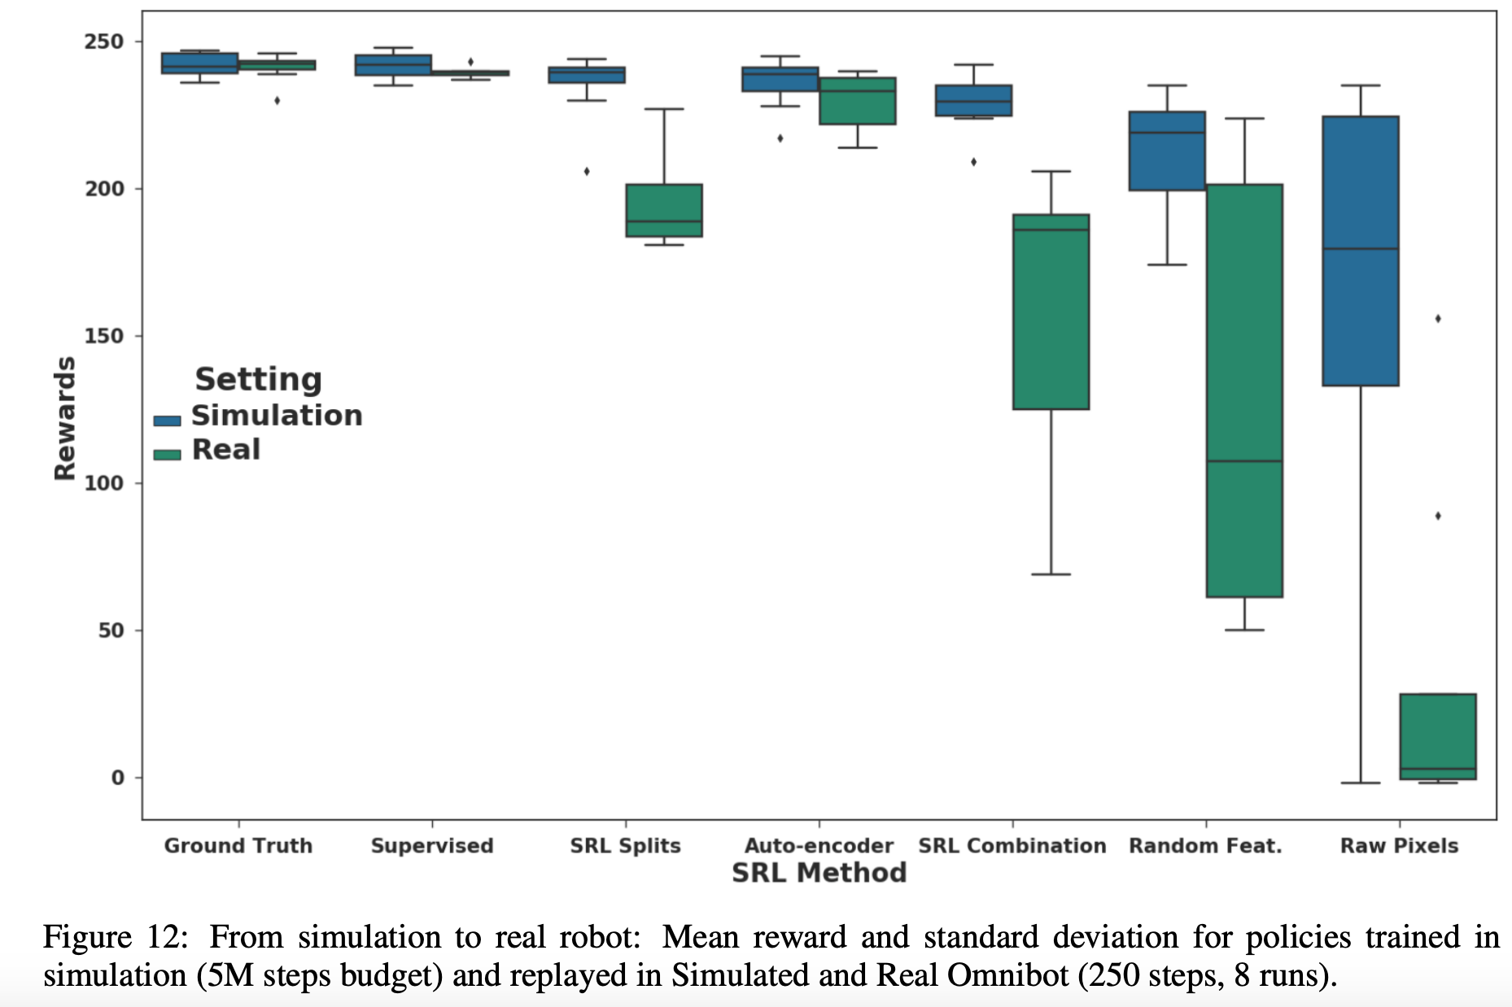
But does not transfer as well…
Sim2Real Transfer:

Slide 23
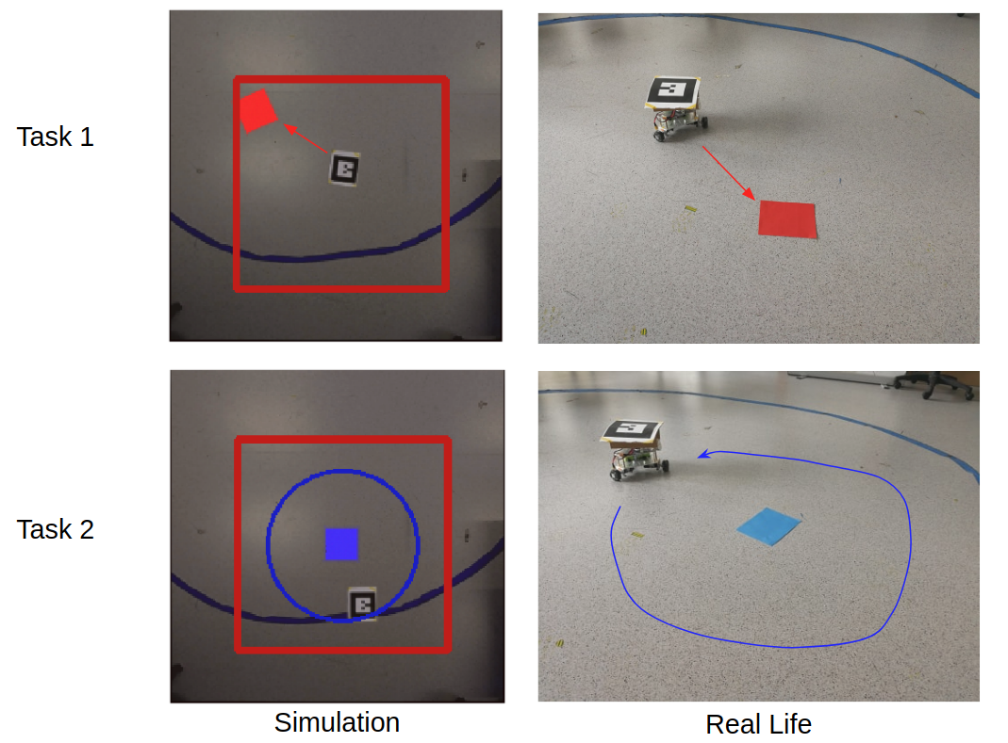
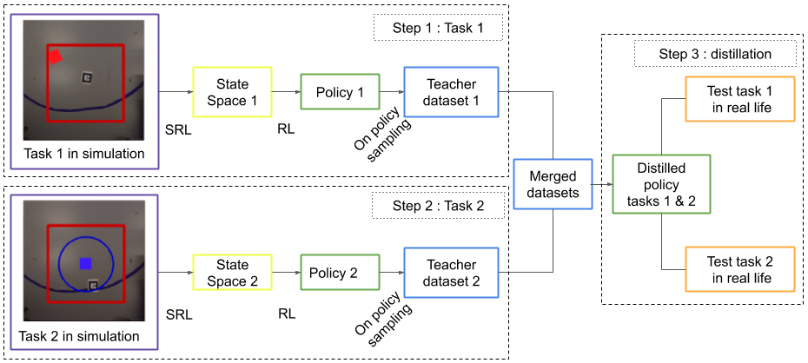
Future Work: Continual RL in Multi-Task, Lifelong,
Real Life Settings
No test time task label
Continual Reinforcement Learning deployed in Real-life using Policy Distillation and Sim2Real Transfer. [Traoré’19]
State representation learning for control: An overview. Neural Networks. [Lesort’18]
Notes:
EXAMPLE OF REHEARSAL APPROACH USING DISTILLATION AND REHEARSAL:
Tasks encountered sequentially, not all at once (no pick & shuffling experiences): Target Reaching (TR) and Target Circling (TC)
No need for task label thanks to distillation and rehearsal

Slide 24
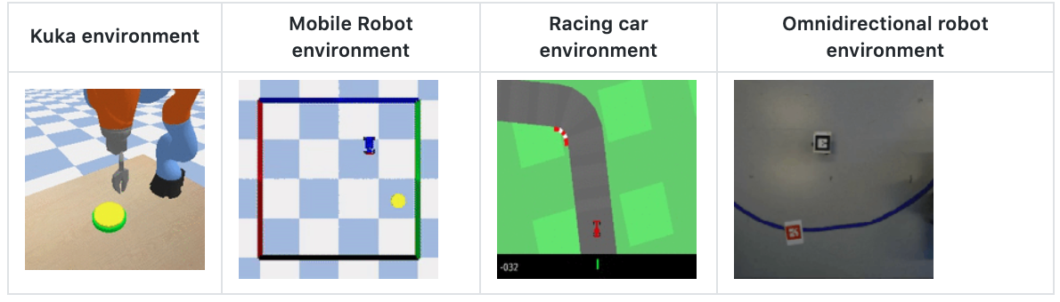
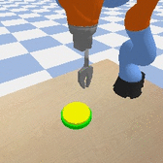
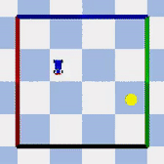
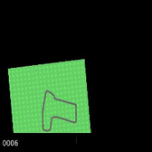
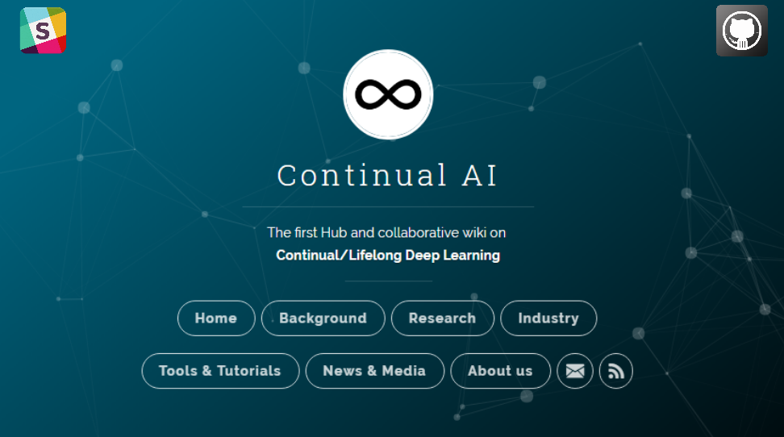

Thank you!
CODE: https://github.com/kalifou/robotics-rl-srl/tree/circular_movement_omnibot
S-RL Toolbox: RL & SRL for Robotics https://github.com/araffin/robotics-rl-srl
natalia.diaz@ensta-paristech.fr https://nataliadiaz.github.io/
@NataliaDiazRodr
Notes:
Appendix: https://docs.google.com/presentation/d/1d_EIWqDGFwcbzN1bAue4ivdMHfGb1NF4VyMdOER40gM/edit?usp=sharing

